Slide 1

Suburban Dreams: The Rise of the Rental Market
Industry Project Group 40
Ingrid Freeman Phoebe Fan Clarissa Hew
Ngoc Duy Tran Yasa Danavira Tjoe

Slide 2



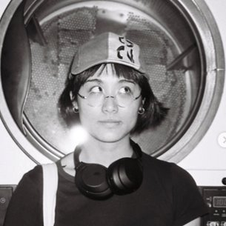
Our Team
INGRID
DUY
PHOEBE
YASA
CLARRISA
Loves a swim, playing footy, and making music with her friends
If intelligence is a weapon, I’m unarmed
Loves to play violin and tennis, and enjoys having a swim
Would talk about anything with anyone. Lives to eat (and drink), sleep is non-negotiable
Loves cooking and sewing

Slide 3
Forecasting the rental market in Victoria
Introducing the Problem . . .
Ever-increasing cost of living in Australia
Slowing economic growth
Rising interest rates
→ Increasing rental population
Key Questions
Q1: Most important internal and external features in predicting rental prices?
Q2: Top 10 suburbs with highest predicted growth rate?
Q3: Most liveable and affordable suburbs?

Slide 4
Timeline & Communication
Sprint 1
Sprint 2
Sprint 3
Sprint 4
Sprint 5
Sprint 6
Sprint 7
Data Acquisition
Preprocessing
Analysis & Visualisation
Machine Learning
Deliverables

Slide 5
ACQUISITION OF DATA
RENTAL DATASETS
Sources
Issues/Challenges (eg. Missing data imputation)
Internal Features
OTHER DATASETS
Sources
External Features

Slide 6
PREPROCESSING
AJKSDFHASKLDFASLDFKA
Don’t know if we need to mention this in PP?

Slide 7
MODELLING
AJKSDFHASKLDFASLDFKA

Slide 8
Determining factors of rental price

Slide 9
Title based on whatever features are used in PP visualisations
Dsjgh9oifjasdpfamsdfpa;dfafa

Slide 10
Determining factors of rental price
Include whichever features are most relevant

Slide 11
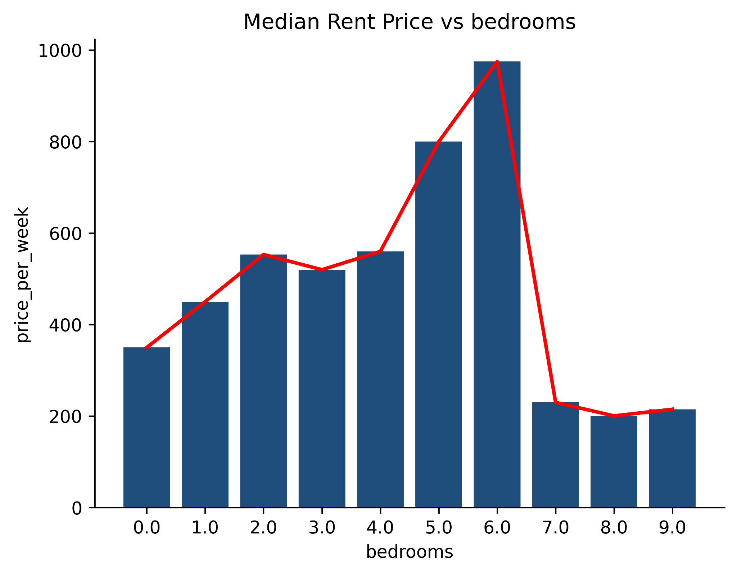
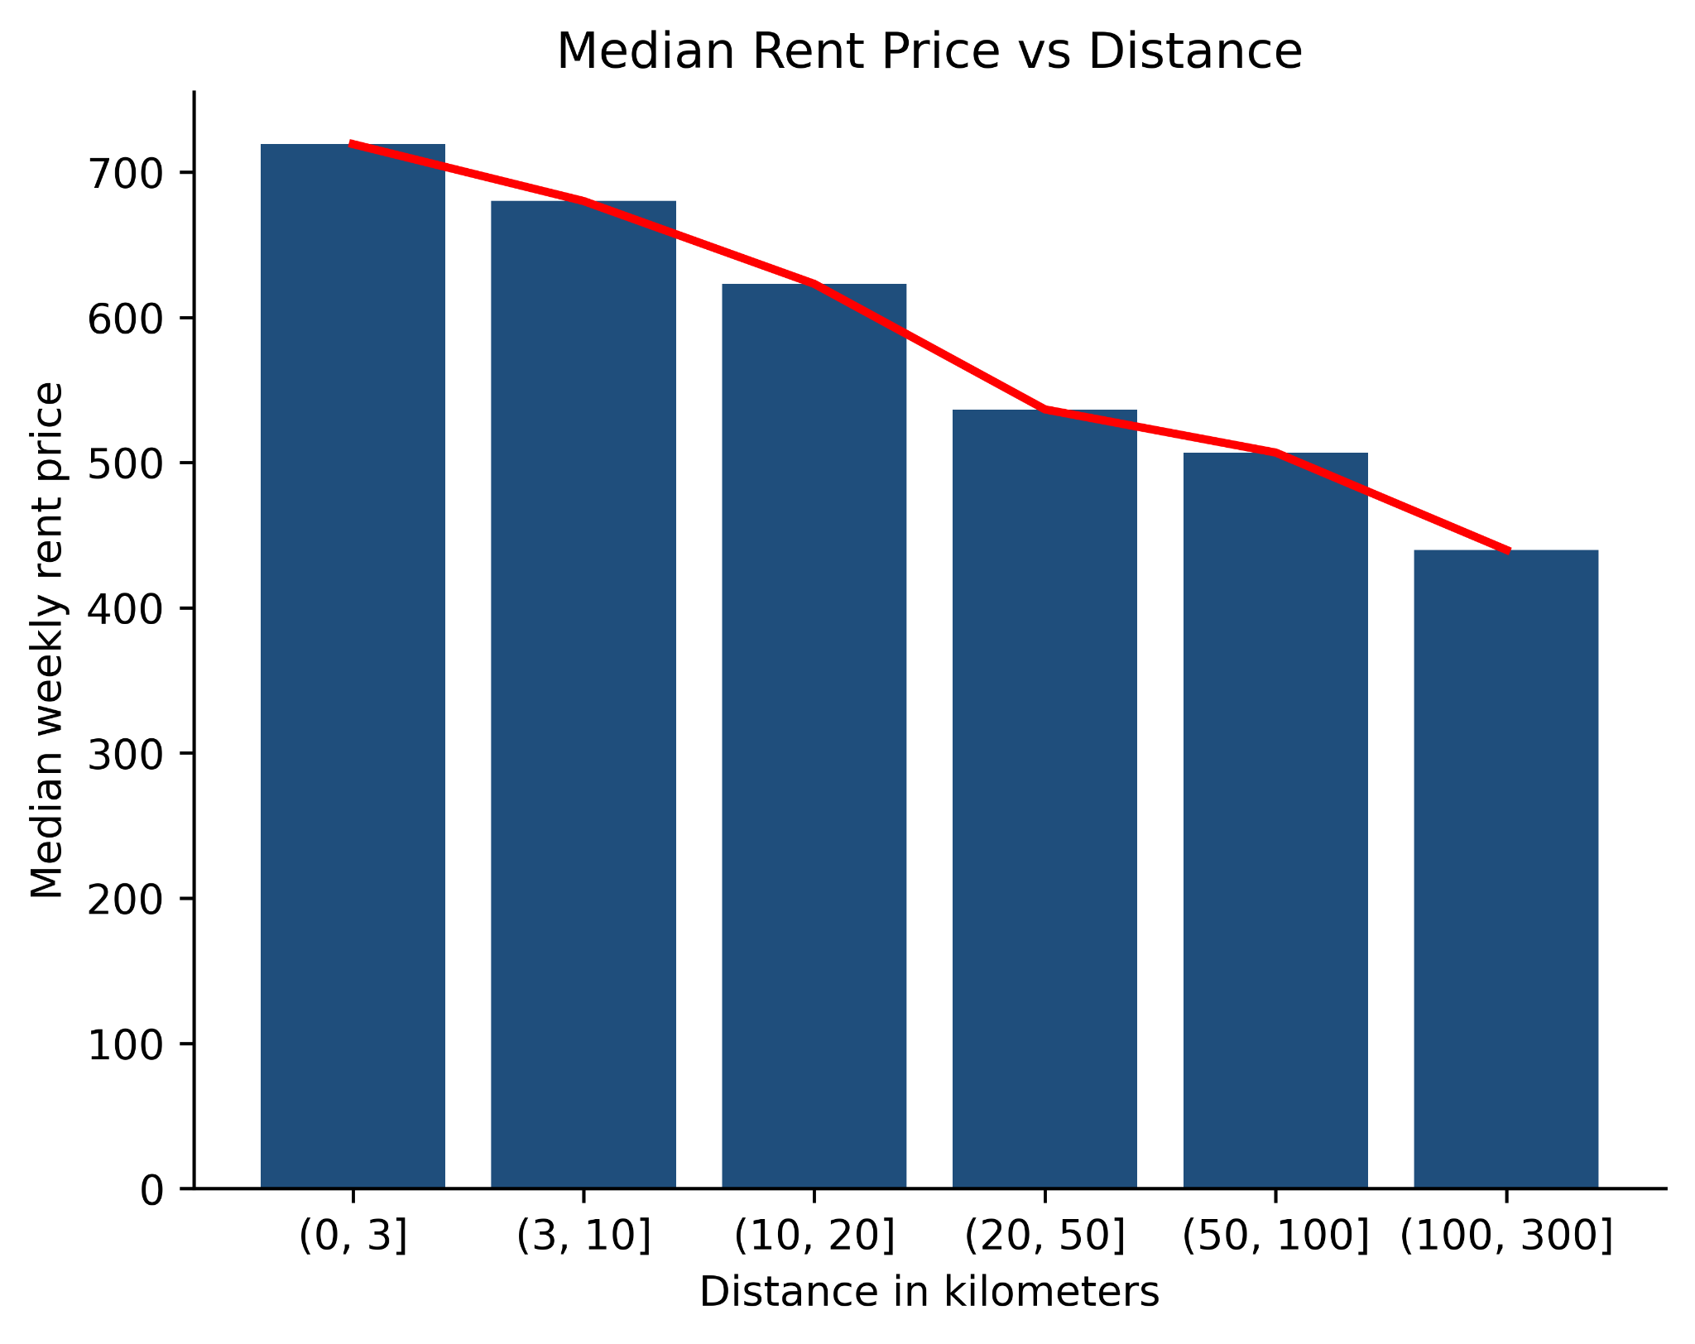

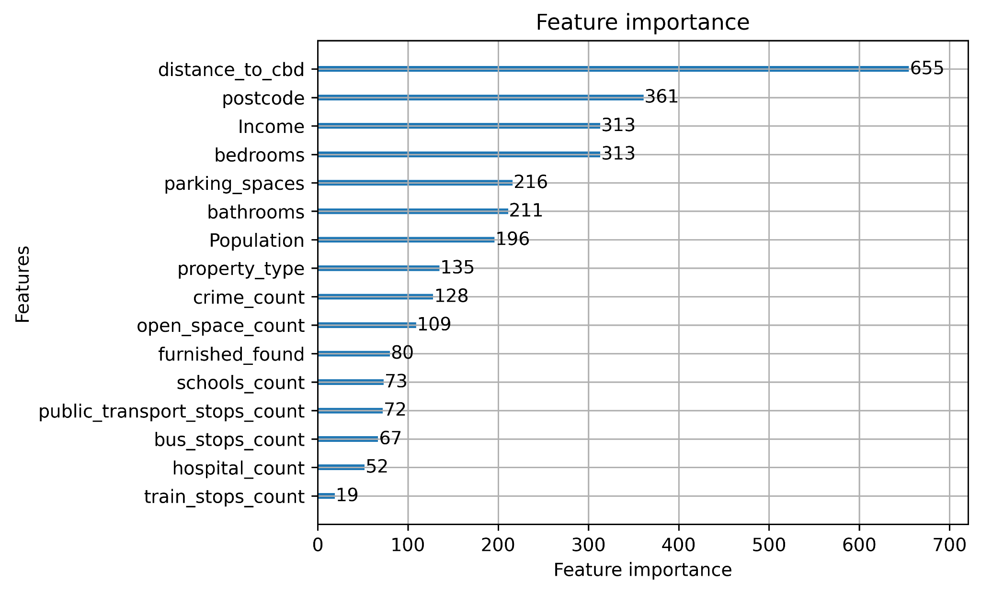
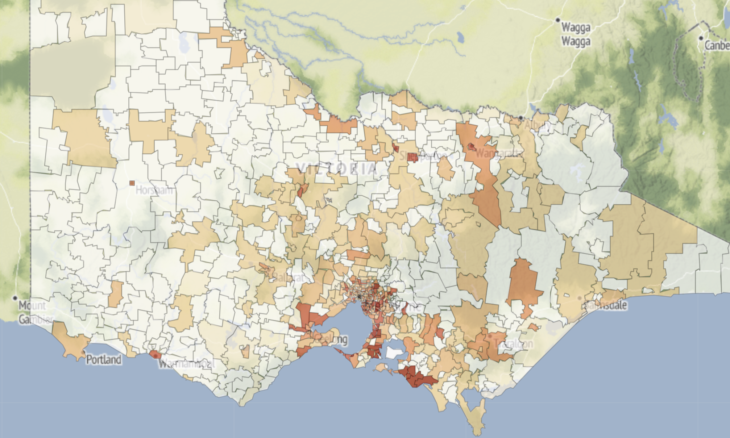



FEATURE PRIORITY
Distance to CBD
Far away from CBD ~ less expensive rent
Postcode
Some are much higher, and lower
Income
Affordability
Bedrooms
Bedrooms
More bedrooms ~ more area
More bedrooms ~ more area

Slide 12
Suburbs rising in Popularity

Slide 13
Most liveable & Affordable suburbs

Slide 14




LIVEABILITY
DEFINING LIVEABILITY
All our liveability factors are linked to the United Nations Sustainable Development Goals:
Access to healthcare and hospitals
Access to schools, childcares, and universities
Access to open and green space
Connectivity through public transport
Absence of crime
Notes:
We drew upon the method of livability calculated by the Australian Urban Observatory.
This takes stock of all relevant United Nations Sustainable Development Goals which contribute to the everyday lives of residents, so all of our livability factors are also linked to these. Each of these features was then standardised and given a weighting. For example the number of train stops has a higher weighting than the number of bus stops, given trains provide faster travel connections in to the city and surrounding suburbs. Crime was also given a negative weighting, given this is an undesirable feature. Each suburb was then assigned a liveability score out of 100, with the highest ranking suburb being 100 and the lowing given 0.

Slide 15
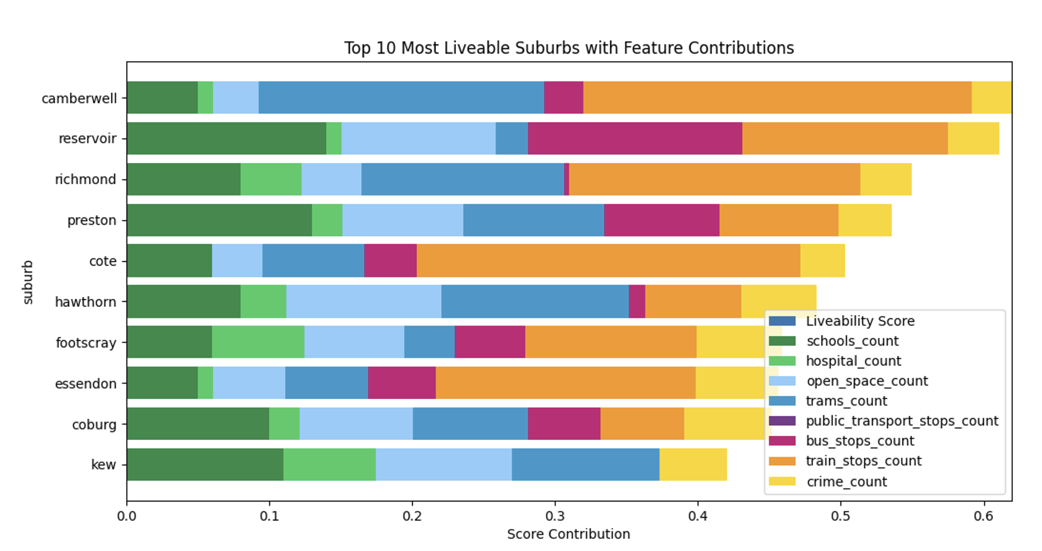
VICTORIA’S MOST LIVEABLE SUBURBS
Notes:
Camberwell has great connectivity, with train and tram stops contributing the most to it’s high livability. Reservoir and Preston have lots of schools and open spaces, so are great places for families. All of the most livable suburbs have low crime.

Slide 16
AFFORDABILITY
DEFINING AFFORDABILITY
‘The state of being cheap enough for people to be able to buy’
Cambridge Dictionary,2023,Affordability, https://dictionary.cambridge.org/dictionary/english/affordability
Notes:
Affordability must acknowledge income, and be relative to this.
Like the liveability calculation, the median rental price and median income were both standardised and given weightings.

Slide 17
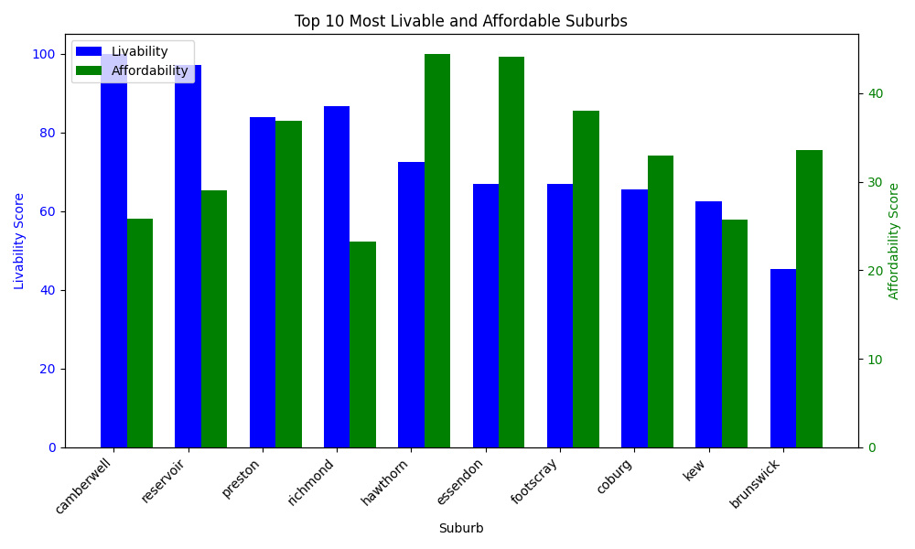
VICTORIA’S UNDERVALUED SUBURBS
Hawthorn, Essendon and Footscray are currently undervalued
Whilst being very liveable, renters will not tolerate further rental increases in Camberwell or Reservoir
Notes:
Camberwell has great connectivity, with train and tram stops contributing the most to it’s high livability. Reservoir and Preston have lots of schools and open spaces, so are great places for families. All of the most livable suburbs have low crime.

Slide 18
FINAL RECOMMENDATIONS
Key takeaways for all 3 questions
Make sure these are in a business context and can be turned into money
Rental prices in Hawthorn, Essendon and Footscray should be revised and brought in line with current market conditions.
Camberwell and Reservoir rent should not be lifted, at risk of renters looking elsewhere.

Slide 19
FEASABILITY OF PROJECT
CURRENT VALUE PRODUCED
POTENTIAL VALUE TO BE EXPLORED
Instead of using affordability based on average income, divide population into different categories by income, then determine affordability for each of these groups

Slide 20
THANK YOU!

Slide 21
ABOUT ME
STUDIES
Year:
3RD Year student
Degree:
Bachelor of Science
Major:
Data Science
University:
The University of Melbourne
UROP STUDENTSHIP
Completed:
July 2022 – Jan 2023
Host Organisation:
CSIRO H&B (Health & Biosecurity)
Supervisor:
Nagendra Singanallur Balasubramanian
UROP Project:
sySTEMS Initiative
Studying SARS-COV-2 infection and treatment effects through transcriptomics
Notes:
Hello etc.
As introduced, Phoebe, 3rd yr, unimelb, DS
Started studentship a year ago, worked on sySTEMS initiative . . .

Slide 22
sySTEMS INITIATIVE – Biological Premise
AIM
Study SARS-COV-2 infection and the effect of treatment through Transcriptomics
KEY CONCEPTS
Gene Expression: process by which a gene gets turned on in a cell, to make RNA
RNA: help to convert information in cell’s DNA into functional products (eg. Proteins)
Transcriptome: complete set of RNA molecules expressed in a biological entity
Comparing transcriptomes across different groups:
Differential Gene Expression
Effect of using different treatments and models
Determine if treatment is effective
Which genes are being up- or down-regulated between different comparison groups?
What is the function of each up- or down-regulated gene?
Do these changes help to fight Covid-19?
Notes:
Before starting my placement, I certainly had no idea what transcriptomics was, so while some of you probably understand this better than I do, I thought it might be worth contextualising all the same!
Some key biological concepts are that of Gene Expression . . . Etc.
With all that in mind, my focus was analysing the differential gene expression
By observing which genes are significantly up- or down-regulated . . . can understand the effect of using different treatments and models
Important to note: each gene has a particular function (some = help fight Covid)
By looking at the function of each up- or down-regulated gene, can determine if treatment = effective

Slide 23
sySTEMS INITIATIVE – Significance
DETAILS
Commercial Models:
Alveolar
Airway
STEM cell-derived Models:
Cardiomyocyte
Nasal-Epithelial
Virus: SARS-Covid2-delta variant
Drug: Remdesivir
PURPOSE
Validate use of tissue models in this context
Use systems biology approach to study innate response in presence/absence of viral drug
MOTIVATION & IMPORTANCE
Safe, effective and affordable therapeutics for Covid-19 are needed
Unsure if current Covid-19 vaccines will also protect against future variants
Global vaccine inequality
Using 3D tissue models (ex vivo) = middle ground
In vitro: evaluation of antiviral efficacy = insufficient
In vivo: complex, costly financially & time-wise
Notes:
In project, 4 3D tissue models were used – from organs typically affected by Covid
Purpose was two-fold: firstly . . . secondly . . .
The motivation for this project was really interesting:
(Need for . . .)
3D tissue models = middle ground between the more traditional in vitro and in vivo approaches
In vitro studies – effect of treatment in cell lines may be different to their effect in living organisms – insufficient by itself
Why it’s usually used in combination with in vivo studies
BUT in vivo approach is . . . serious implications
In case of covid, hundreds of thousands of ppl . . .
Less options can be explored thoroughly (eg. Types of drugs)
3D tissue models = SOLUTION (quite literally saves lives)

Slide 24
sySTEMS INITIATIVE – My Role
VARIABLES
Model: Alveolar, Airway, Nasal, Cardiomyocyte
Treatment: Mock, Drug, Virus, Therapy
Day: 1, 2, 3, 4
RESPONSIBILITIES & TASKS
Work with data in R (in form of gene counts)
Visualise differential gene expression
Complete KEGG pathway analysis
Contribute to writing 2 research papers
COMPARISONS
“Within-model” comparisons
Holding model and day constant, look at differential gene expression between treatments
Holding model and treatment constant, look at differential gene expression between days
“Between-model” comparisons
Holding treatment and day constant, look at differential gene expression between models
RESULTS . . .
Notes:
Role + Responsibilities
Starting point = data (not involved with data collection etc.)
I wrote code using R – due to time, won’t go into details . . . (coding process/statistical analysis)
TASKS
Comparisons – within model, between model
Results
WHILE I was able to complete all the statistical analysis and visualisations etc.
MORE WORK that needed to be done regarding the immunological implications of results – placement concluded before had time to do this

Slide 25
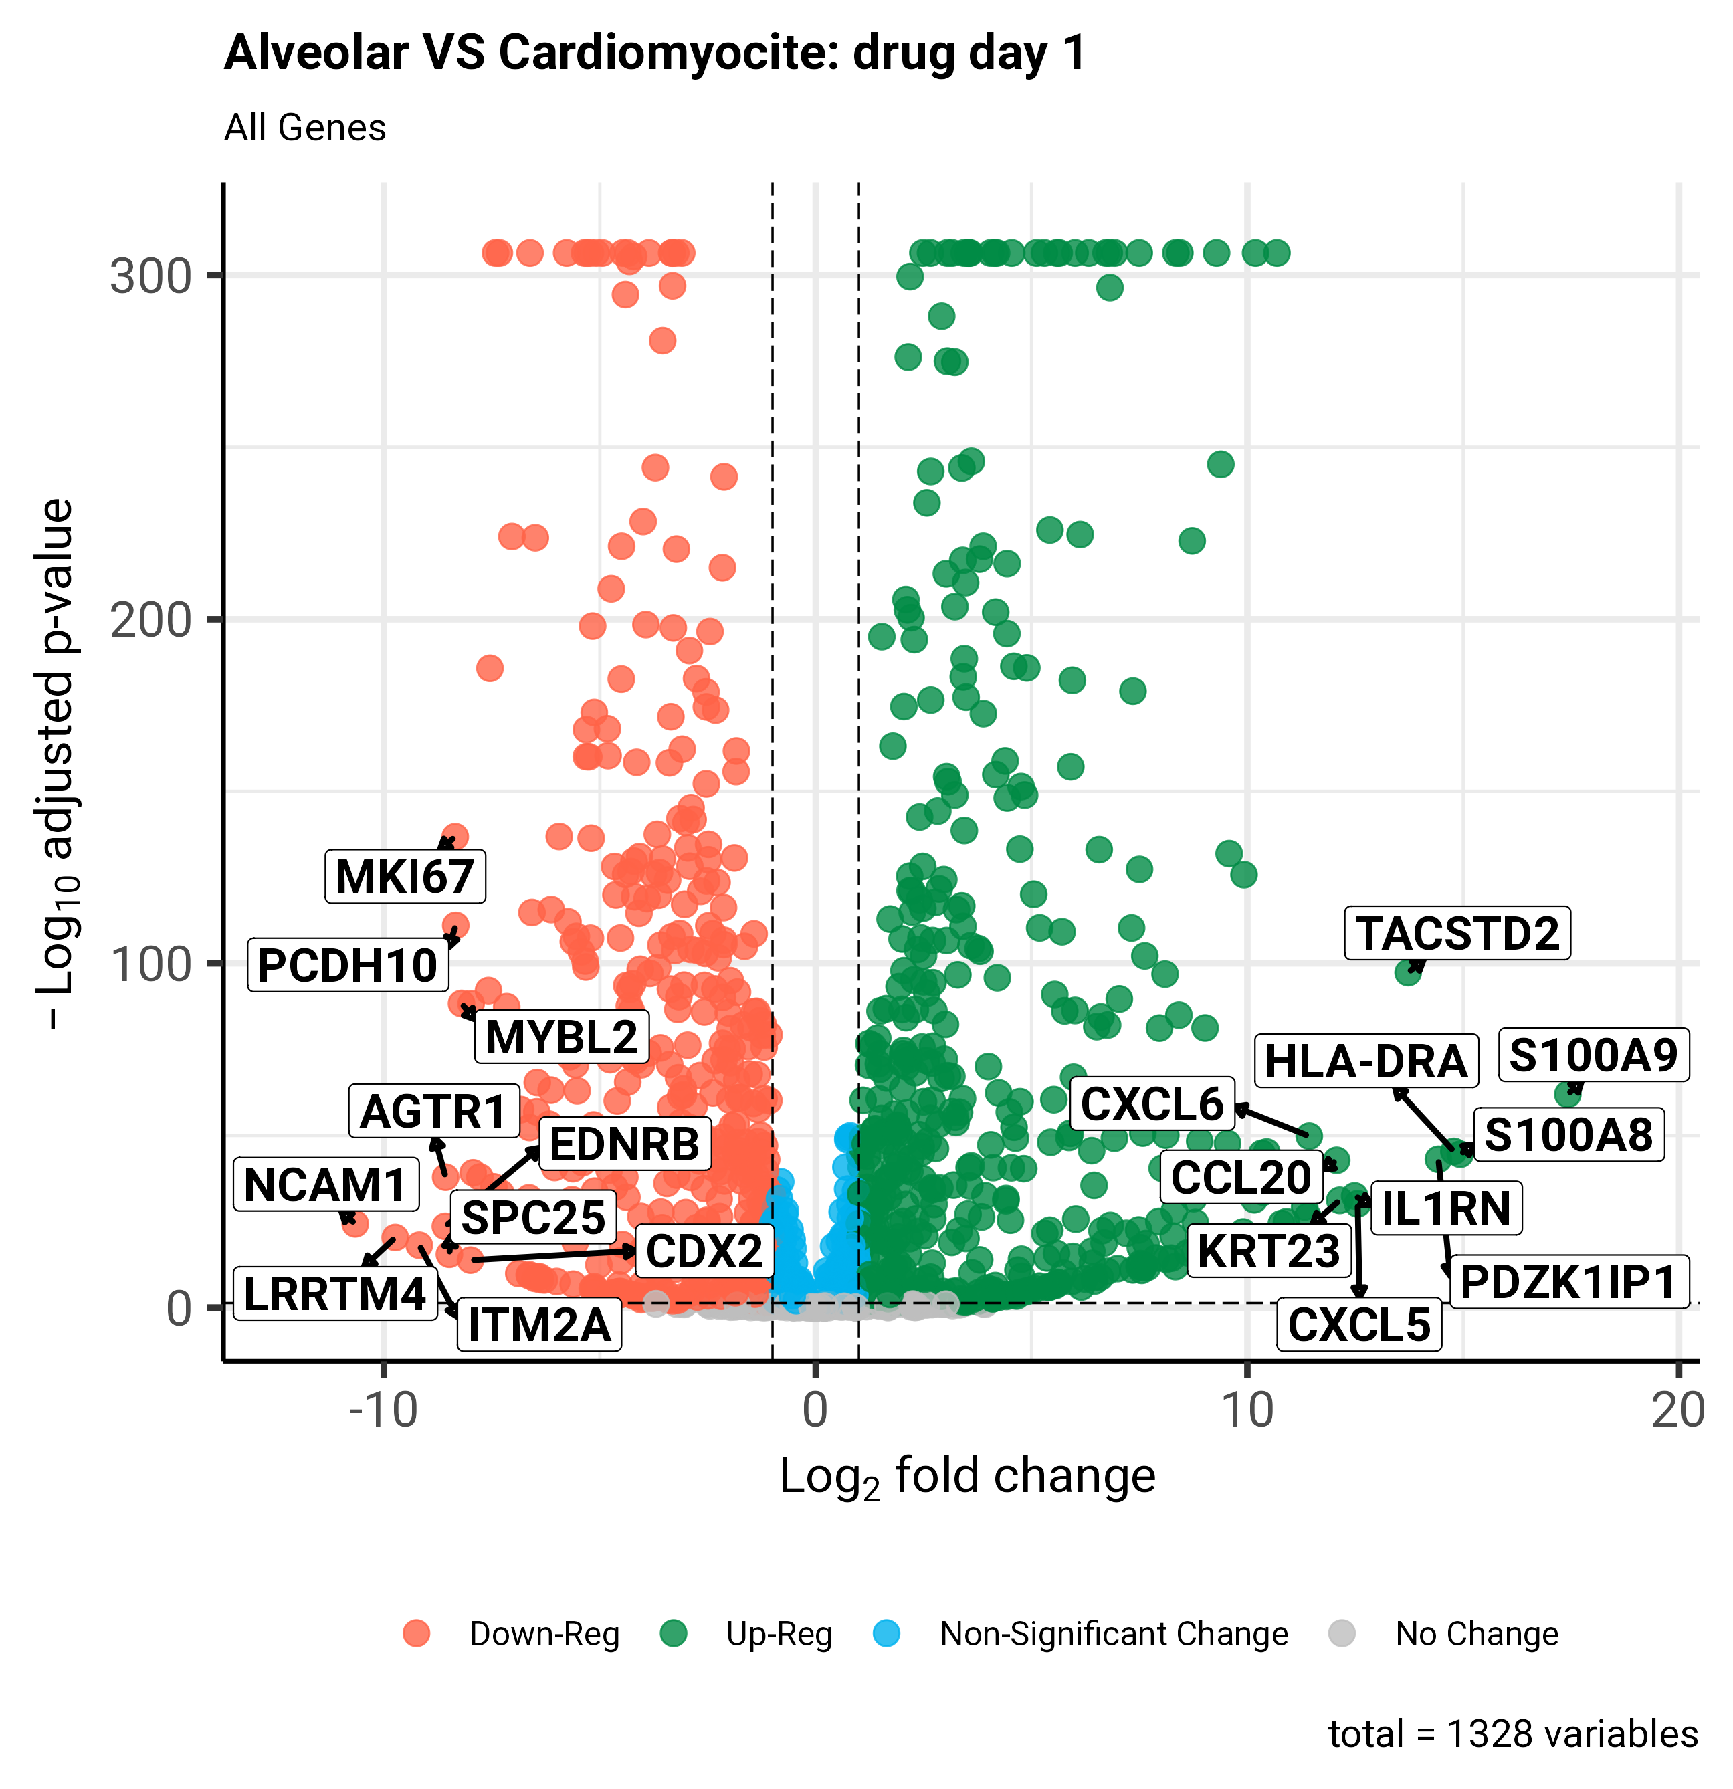
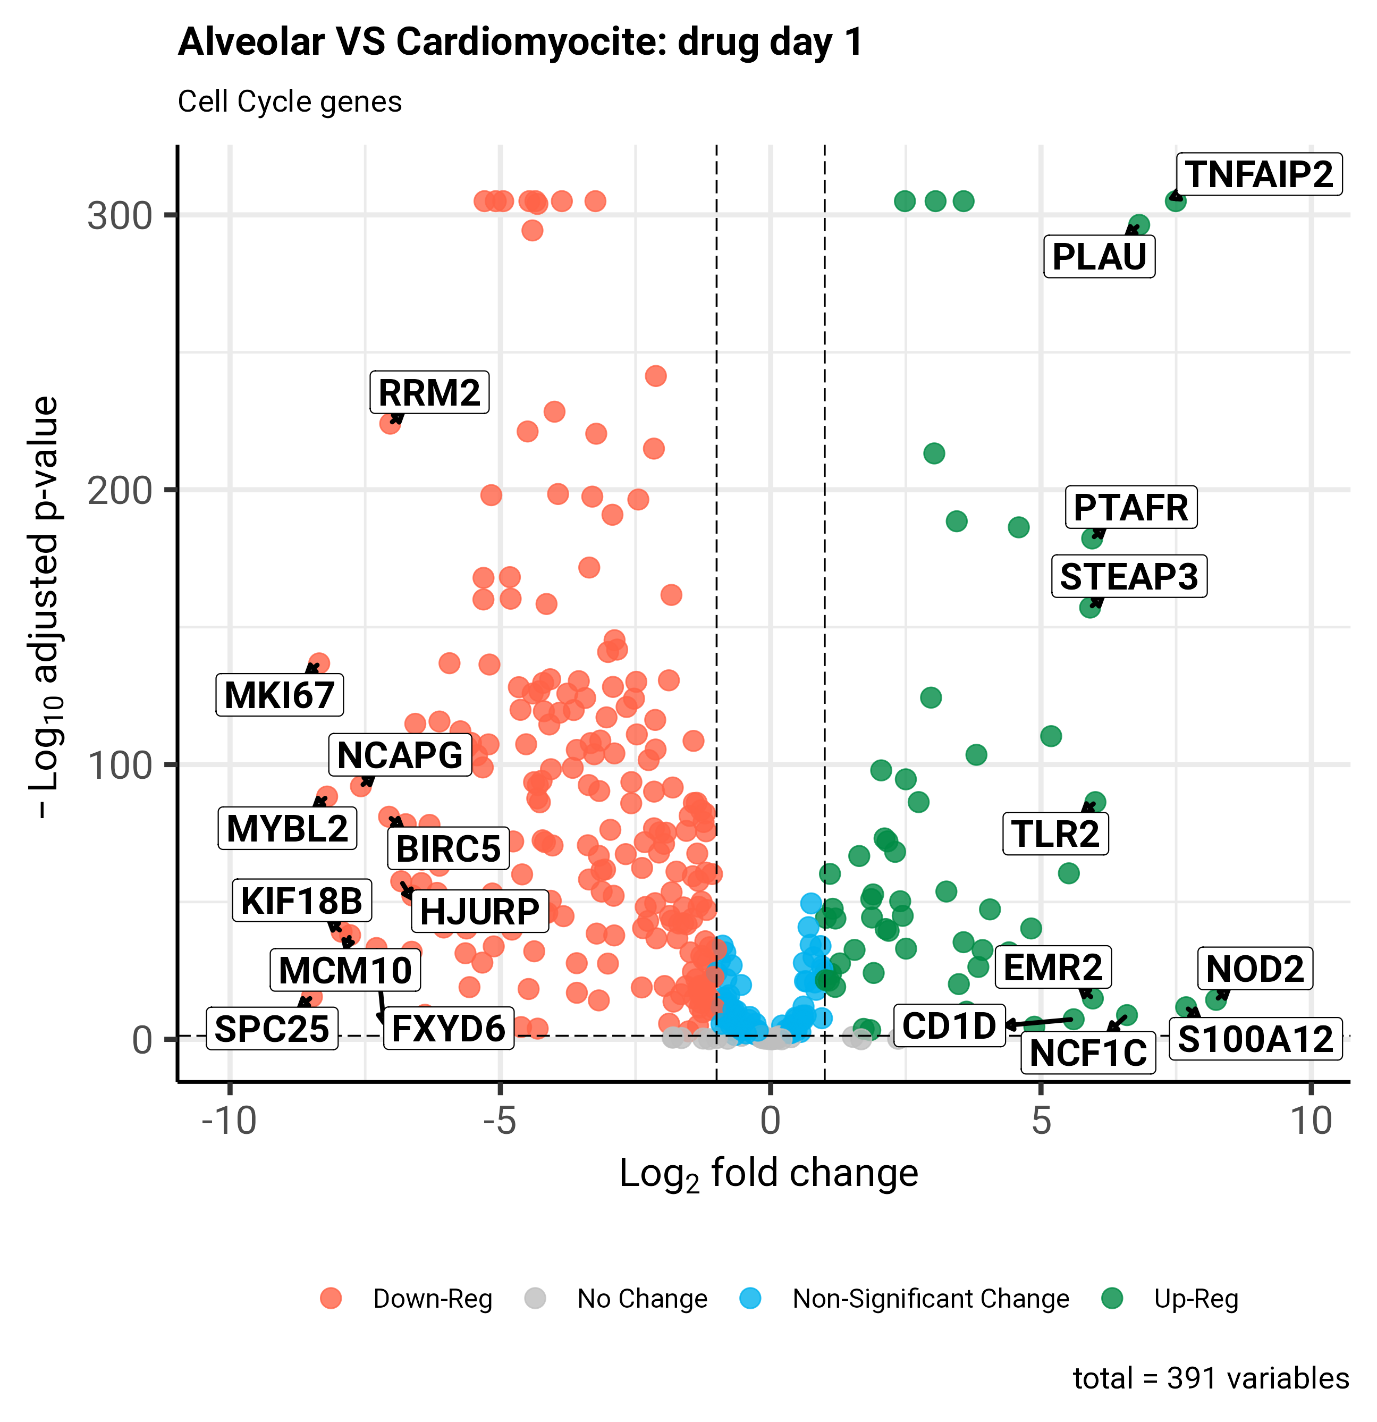
VOLCANO PLOTS
Notes:
Used volcano plots to visualise diff gene expression
Essential component: colour-coding to indicate if which genes had been up- or down-regulated and if this change was significant or not
Additional functionality to facilitate easier and better analysis (zoom in and out)
Labelling of genes
Filtering which datapoints are shown based on the gene function

Slide 26
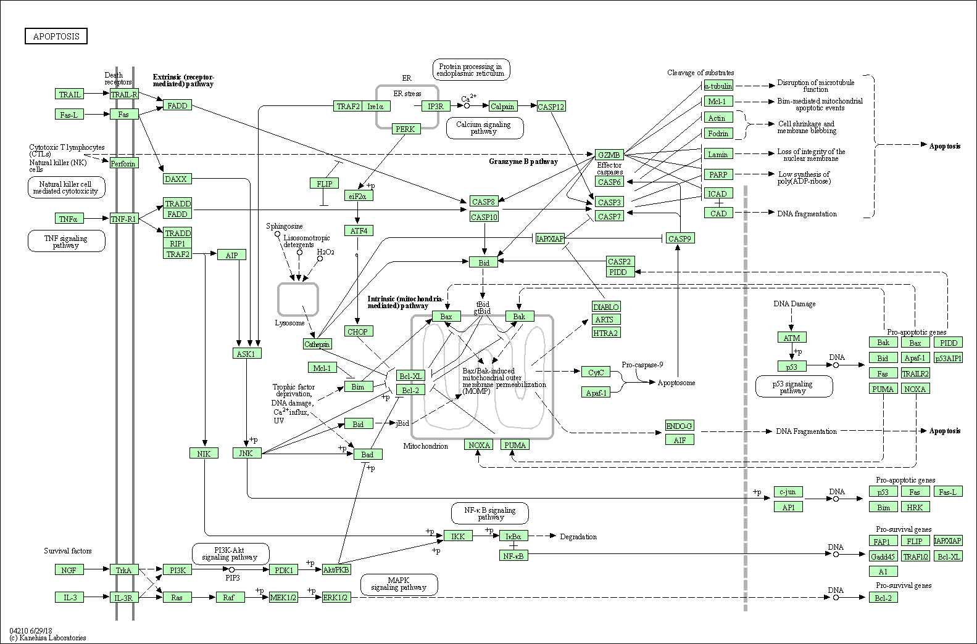
KEGG PATHWAY ANALYSIS
Using DAVID – Functional Annotation Tool
Always differentially expressed
Sometime differentially expressed
Notes:
KEGG PATHWAY ANALYSIS:
Genes are connected to each other in what are called pathways
Different genes contribute to different sequential steps of a biological pathway
Genes interact with each other – like a chain reaction (between pathways and within pathways)
KEGG – helps give biological context to what is shown in the data (tells the story)

Slide 27
LEARNING EXPERIENCE
Knowledge:
Better understanding of what bioinformatics is, and where it can be applied
Understanding of systems biology and transcriptomics
Experience & Skills:
Experience working with real data (uncontrolled environment)
Greater appreciation of the complexity of biological data, and the huge amounts of data to be analysed
Experience working in a research team
Inter-disciplinary communication and collaboration
Exposure and contribution to research paper writing
Notes:
KNOWLEDGE:
Lots of new knowledge of course – systems biology, transcriptomics, etc.
BUT biggest takeaway – greater understanding and appreciation of the role that data science can play within the health and research sector
Going into the future . . .
EXPERIENCE + SKILLS:
One highlight was course contributing to such highly relevant research and gaining experience writing research papers (currently still in the process of writing)

Slide 28
ACKNOWLEDGEMENTS
Funder of sySTEMS Project: NHMRC-MRFF
UROP Studentship: CSIRO Education and Outreach
Stipend: Biosecurity Program
Supervisor: Nagendra Singanallur Balasubramanian
Notes:
Thank everyone +
Nagendra:
Immunomics Team – involving/welcoming me
All other staff/students who I’ve met:
Have helped to make this a really great experience, from which I’ve learnt a lot.

Slide 29
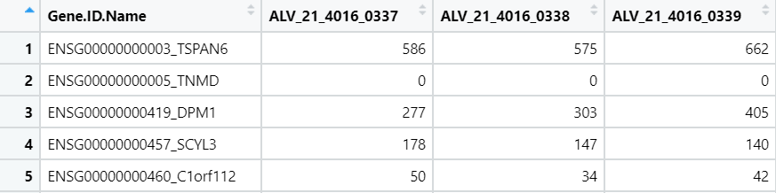
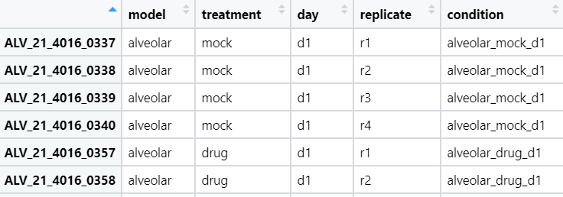
DATASETS
COUNT DATA
Samples
Count
Genes
METADATA
Information about each sample
Samples
Notes:
As I was comparing 2 models, I had 2 datasets – 1 for the cardiomyocyte model, and 1 for the alveolar model.
For each model, I was given the count data, which was a matrix containing the counts for each gene, for each sample. Along the left, we have the genes, and along the top, we have the samples.
I was also given the metadata which identified the model, treatment, day and replicate number of each sample

Slide 30
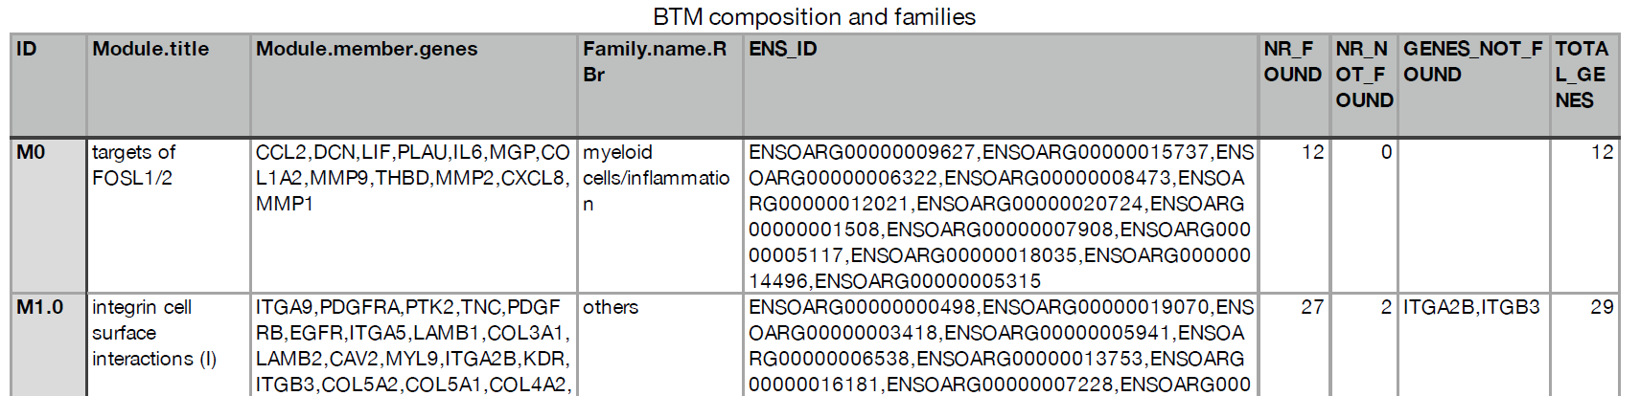
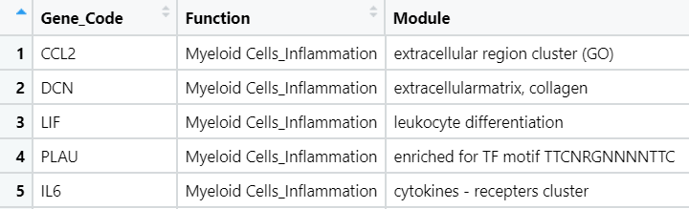
Additional Data
Braun et al (2018) – supplementary file
New data frame
Notes:
However, I also needed a way to identify the function of each gene. The supplementary file from a research paper (Braun et al. 2018) contained this information , so I wrote an R script to transfer this information into a usable form, creating a csv file which mapped each gene code to the gene function. This was later used in the main coding process.

Slide 31
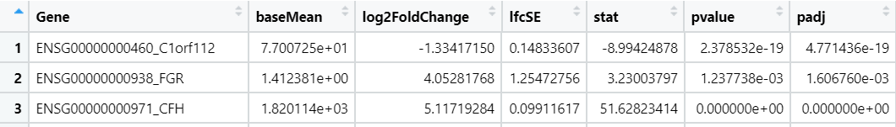
Timeline & Communication
Methods used:
DESeq2 analysis (in R)
KEGG Pathway analysis (using DAVID)
Combining Data
Filtering
Comparing Models
Categorising Genes
Visualising Data
Analysis
Using DESeq2 library
Removed genes without known function
Removed genes with too few counts
Indicates significance of gene’s differential expression
Indicates whether a gene has been up-/down-regulated or not, and by how much
Notes:
The remainder of my code was also written in R. The main methods used were DESeq2 analysis in R, and KEGG pathway analysis.
As I had 2 separate datasets for the cardiomyocyte and alveolar models, my first step was to combine the count data for each into a single data frame. The same was applied to the metadata for both models.
**
Following this, I needed to filter the data. First, any genes without a known function were removed. This was done using the csv file mapping gene codes to their function, as shown on the previous slide. This ensured that the remaining genes all had a known function, and would be meaningful to later analysis.
Next, any genes which had less than 1 count per million in most samples were removed.
**
This filtered data was then used to analyse the differential gene expression between the cardiomyocyte and alveolar models. Holding the treatment and day constant, the counts for the 2 models were compared. This was done for each combination of treatment and day, using the DESeq2 library in R.
Each time, output was produced containing statistical measurements, as seen on the screen. Out of these measurements, the log2FoldChange and adjusted p-value give us information about whether a gene has been significantly up- or down-regulated or not.
If the log2FoldChange is at least 1, then the gene has been upregulated. If the log2FoldChange is at most -1, then the gene has been downregulated.
If the adjusted p-value is smaller than 0.05, then the gene has significantly changed.
For example, . . . (refer to genes in PP)
**
These measurements allow us to categorise the genes into 4 categories: significantly up-regulated, significantly down-regulated, non-significantly changed or not changed.
This can be visualised using a volcano plot.

